Slide 1
Let’s Talk Python:
Intro to the Coding Language
Timothy Hoang
Austin Hispanic Hackers
November 12th, 2020

Slide 2
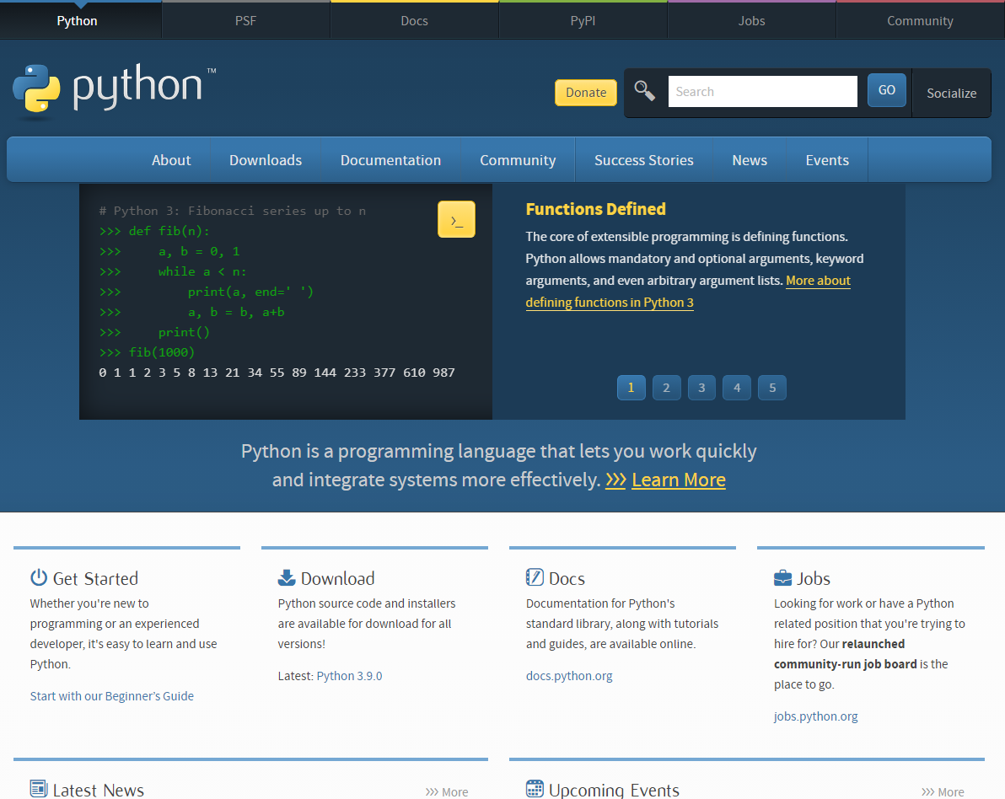
Presentation Layout
python.org
Slides & Github provided
Self-introduction
What is Python?
Why learn Python?
Python & other languages
Running Python
Python Strings
Python Functions
Python Classes
Resources
Action Steps
Closing
Notes:
Slides Link https://docs.google.com/presentation/d/1Kiwb1npDhaCeL4b7mH5KmGeIo2vqXaT3Ch-oOCfIfj4/edit?usp=sharing
Github Link https://github.com/timh1203/python_talk_shpe

Slide 3



Self-Introduction
Currently, Web Applications Developer @ OpenSymmetry
Associate FS Web Developer @ Tenavox
Pivoted career from Pharmacist after about 3 years
Away from pharmacy, towards Medellin
My Pharmacy Desk
My current stop

Slide 4



Self-Introduction
Freelancing/autodidactic period (1 year)
Freelance in VA, traveled to CO, taking online courses
Lambda School (7 months)
Online 7-month full stack web development & CS academy
Was completely remote, went to GDL, GTO, MTY
I like learning about investing/trading stock markets, traveling, and learning Spanish
Stop in Guanajuato during LS
Started LS in Guadalajara
Finishing up LS in Monterrey

Slide 5
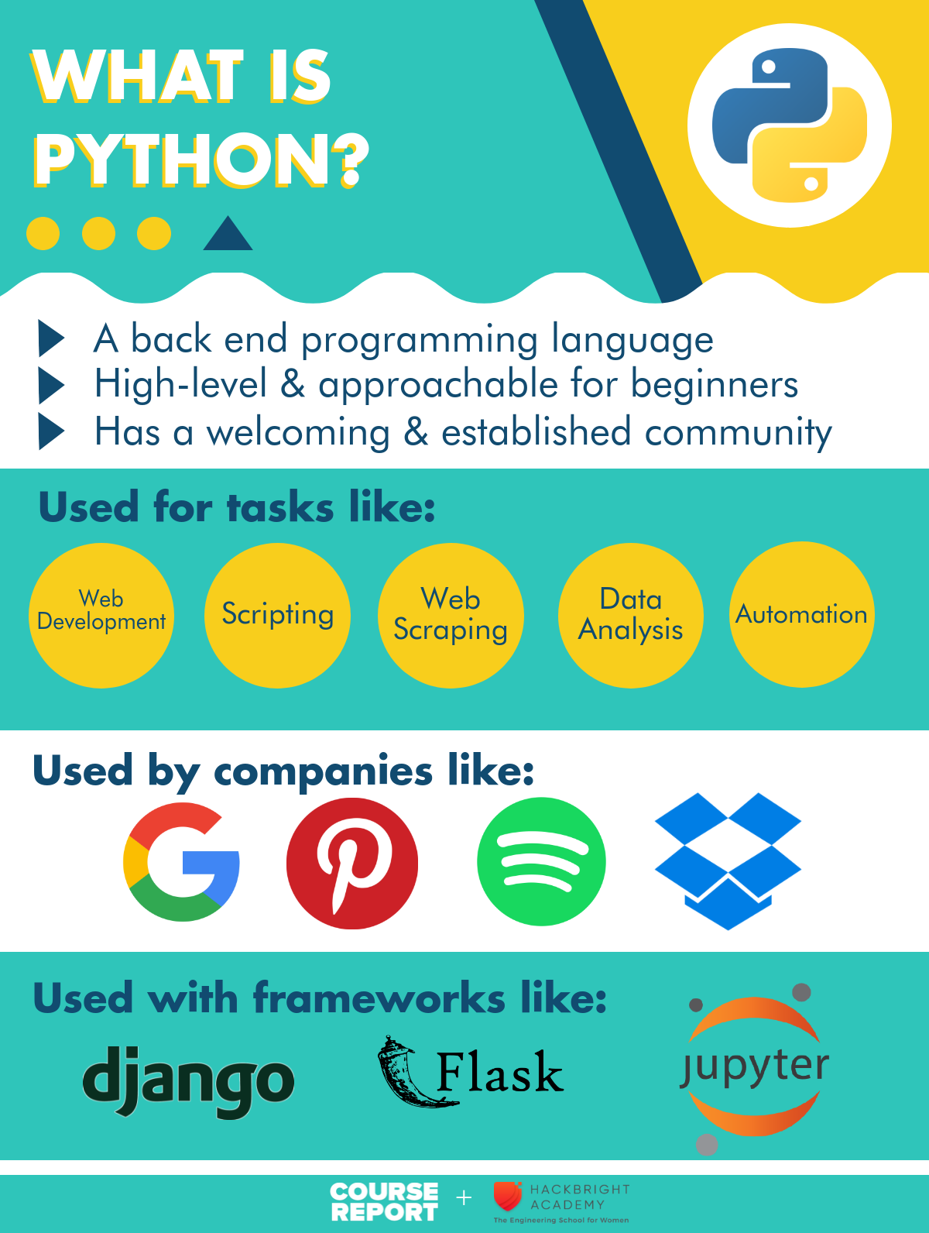

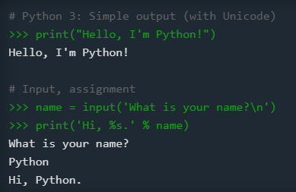
What is Python?
Object oriented, back-end language
Simple language for rapid development
Released in 1991 by Guido van Rossum
Name from being “a big fan of Monty Python's Flying Circus”
Most recent version is Python 3
Python 2 is still popular, End Of Life on 1/1/2020
wikipedia.org
python.org
coursereport.com
Notes:
About Guido https://en.wikipedia.org/wiki/Guido_van_Rossum
Official Python Introduction https://www.python.org/doc/essays/blurb/
W3Schools Python Introduction https://www.w3schools.com/python/python_intro.asp
Differences in Python 2 and 3 https://www.geeksforgeeks.org/important-differences-between-python-2-x-and-python-3-x-with-examples/
Course Report https://www.coursereport.com/blog/what-is-python-programming

Slide 6
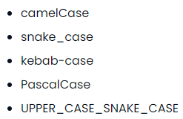
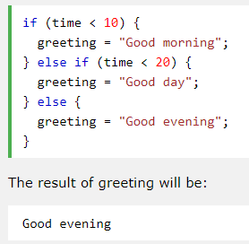
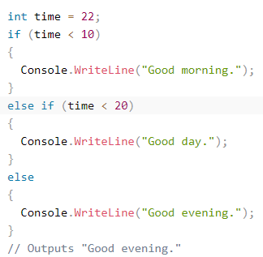
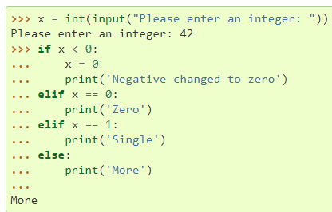
What is Python?
Uses lines and indentation, instead of semicolon or parentheses
Focuses on object/classes , has members and methods
True OOP language with concepts like APIE (abstraction, polymorphism, inheritance, encapsulation)
Uses PEP-8 style guidelines and snake_case typing
chaseadams.io
Python
JavaScript
C#
docs.python.org
w3schools.com
w3schools.com
Notes:
Python Docs: More Control Flow https://docs.python.org/3.9/tutorial/controlflow.html
W3School: JavaScript Conditionals https://www.w3schools.com/js/js_if_else.asp
W3School: C# If...Else https://www.w3schools.com/cs/cs_conditions.asp
Common Programming Cases https://www.chaseadams.io/posts/most-common-programming-case-types/
PEP-8 Style Guidelines https://www.python.org/dev/peps/pep-0008/
OOP Concepts https://beginnersbook.com/2013/03/oops-in-java-encapsulation-inheritance-polymorphism-abstraction/

Slide 7
Why learn Python?
Simplicity, readability, and easy to learn (Zen of Python, use import this)
“Batteries included” language with large standard library
Supports modules for extensibility
Large community, established knowledge base, open-source
Used in web development, data analysis, scientific computing, machine/deep learning, internet of things
Works on many platforms (Windows, Mac, Linux, Raspberry Pi)
Supports many paradigms: procedural, object-oriented, or functional
Web Development Frameworks: Django (2005), Flask (2010)
Has garbage collection
Notes:
Python Standard Library https://docs.python.org/3/library/
Python Modules https://www.programiz.com/python-programming/modules
Django vs Flask https://hackr.io/blog/flask-vs-django
Raspberry Pi 400 Desktop PC for $70 https://www.raspberrypi.org/blog/raspberry-pi-400-the-70-desktop-pc/

Slide 8





Python and Other Languages
Top 5 Languages 2020 from hackr.io
One of the more well-known languages
Use the language that you need for your purpose
Other frameworks and libraries on top of these languages
Looking for a job? Google for top languages of <current year>
Web development? Try JavaScript
Game development? Try C++
Enterprise applications? Try Java or C#
Language closer to the hardware? Try C
Data Analysis/Machine Learning? Try R
Aiming for Google? Try GoLang
Notes:
Python Ranking 2020 https://hackr.io/blog/best-programming-languages-to-learn-2020-jobs-future

Slide 9
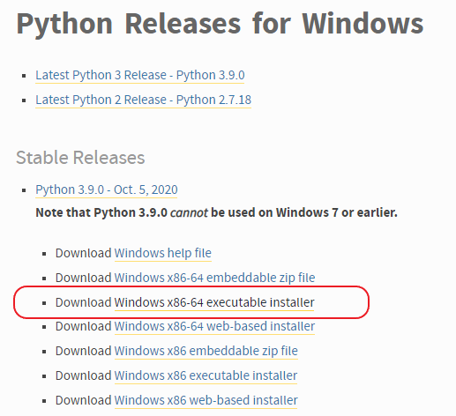
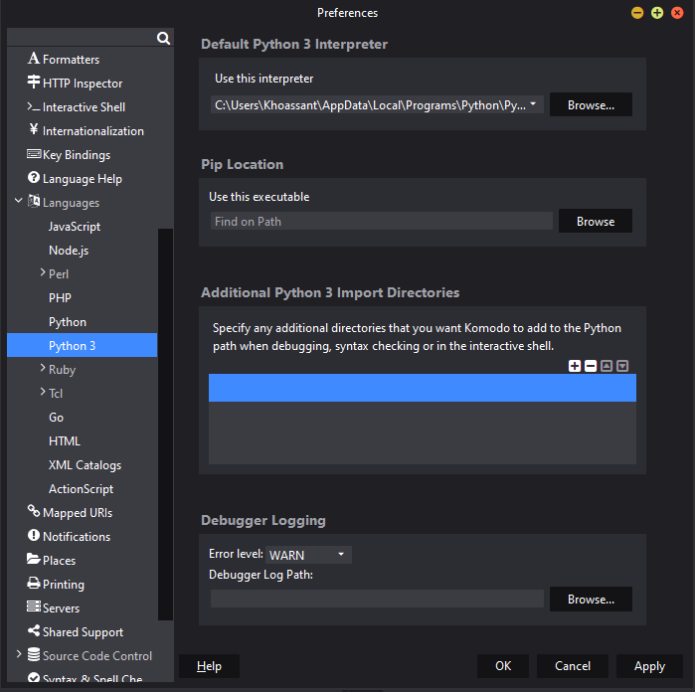
Running Python
wiki.python.org
Python 3.9.0
IDEs: Thonny, Komodo, and PyCharm
1.Downloaded Python 3.9.0 for Windows
2.Downloaded Komodo IDE
3.Registered for free Active State account
4.Run Komodo and choose debugger
5.Run python in the terminal
6.Check out the Python Docs and Resources
Choosing Komodo debugger
docs.activestate.com
Notes:
Dowload Python https://wiki.python.org/moin/BeginnersGuide/Download
Download Komodo https://www.activestate.com/products/komodo-ide/python-editor/
Pointing Komodo Debugger https://docs.activestate.com/komodo/11/manual/debugpython.html My local path C:\Users\Khoassant\AppData\Local\Programs\Python\Python39\python.exe
Python Docs https://docs.python.org/3.9/
Python Getting Started https://www.python.org/about/gettingstarted/
Python Resources https://wiki.python.org/moin/BeginnersGuide/Programmers

Slide 10
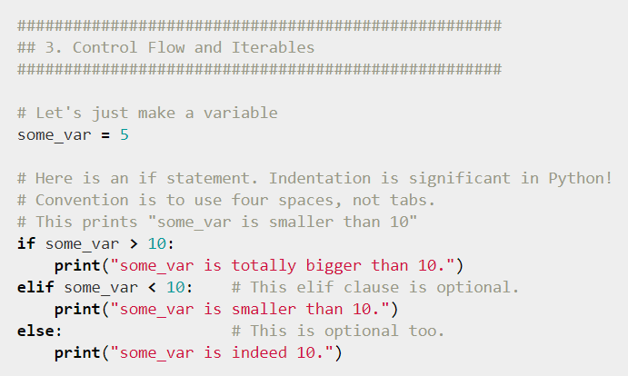
Running commands
4.Try Py terminal commands
py - runs the py terminal
import this - runs the Zen of Python
Shift enters makes a new line
Enter submits a line
exit - exits the py terminal
cls - clears the windows terminal
Try an if-elif-else loop
Try a li = [] (list) and use li.append(), len(li), li.pop() and looping through a list
Try importing the math module and use math.pi, math.ceil, math.floor
5. Use X in Y Minutes to learn more language syntax
learnxinyminutes.com
Notes:
If-elif-else https://docs.python.org/3.9/tutorial/controlflow.html
Import math module https://docs.python.org/3.9/library/math.html?highlight=math%20module#module-math
Learn X in Y Minutes https://learnxinyminutes.com/docs/python/

Slide 11
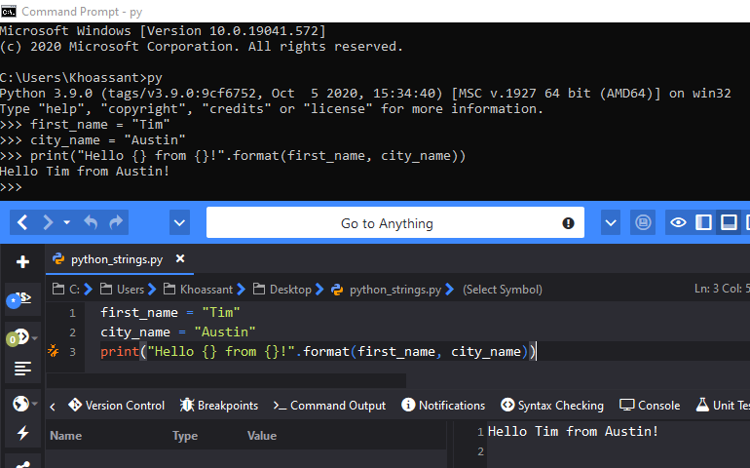
Code Example #1: Strings
Tip: Can’t insert numbers into strings unless you use .format().
Strings display info and helps with debugging
Old way to write strings (line 3)
Terminal introduction
Komodo introduction
Github repo provided
Tip: Create a new file with the Python3 template.
Notes:
Python Strings and using .format() https://www.w3schools.com/python/python_strings.asp
Github repo link https://github.com/timh1203/python_talk_shpe

Slide 12
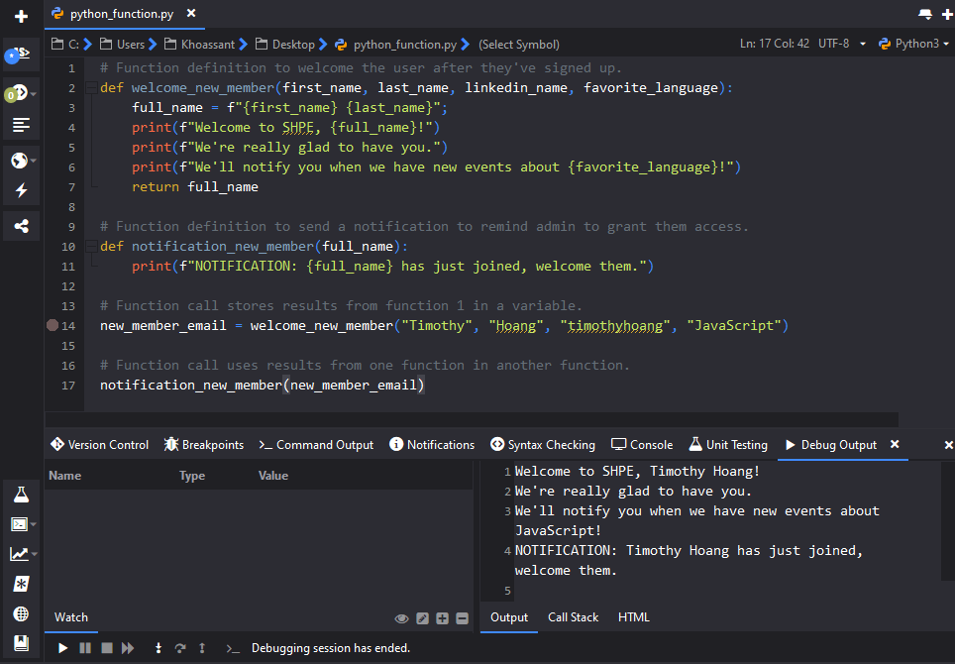
Code Example #2: Functions
Definitions (lines 2, 10)
Calls (lines 14, 17)
Welcome new members
Send admin a reminder
Store member name in variable to use in reminder function
Tip: F-strings or formatted string literals is an easier way to write strings. (lines 4, 5, 6, 11)
Notes:
Github repo link https://github.com/timh1203/python_talk_shpe

Slide 13
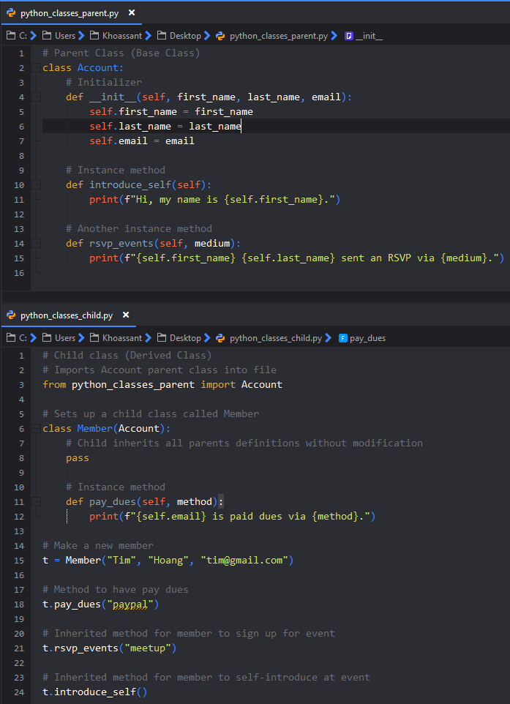
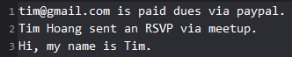
Code Example #3: Classes
Set up a parent class called Account
Properties: first_name, last_name, email
Methods: introduce_self, rsvp_events
Set up a child class called Member
Receives all properties and methods from parent
Use pass to inherit without modification
Own method: pay_dues
Results:
Notes:
Python Docs: Classes https://docs.python.org/3/tutorial/classes.html#class-definition-syntax
Github Link https://github.com/timh1203/python_talk_shpe

Slide 14
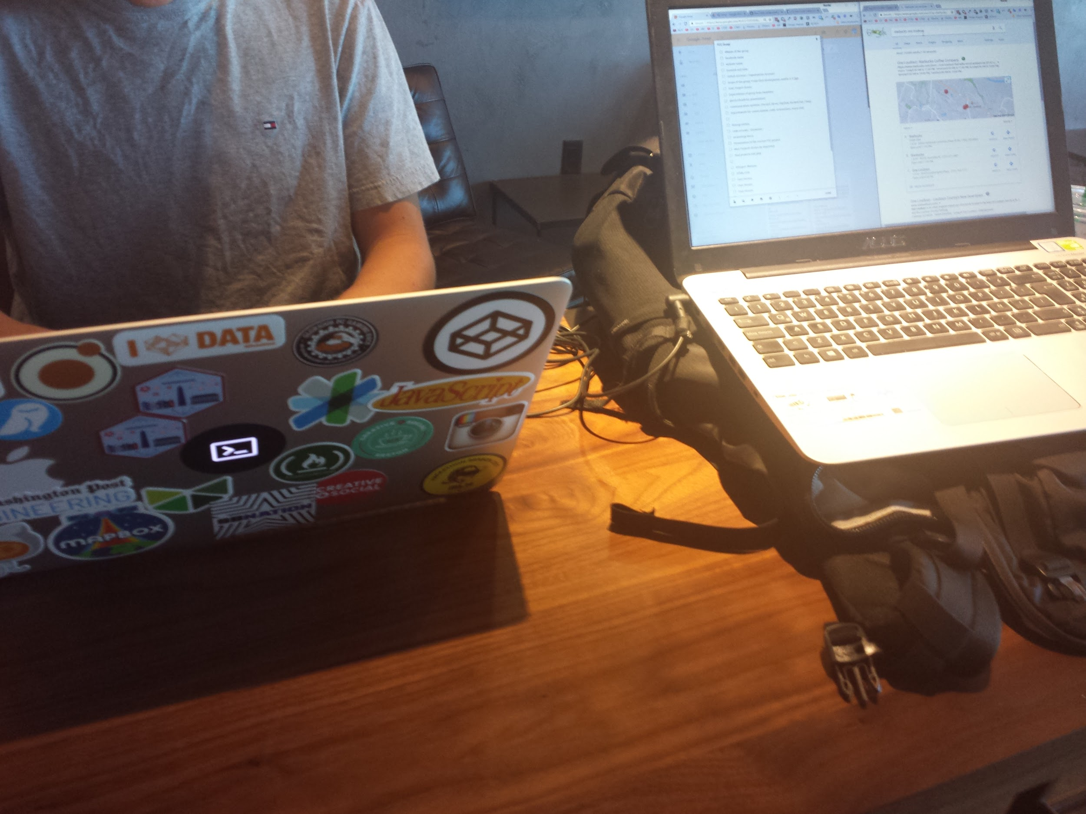
Resources
Official Python https://www.python.org/
Austin Python Meetup https://www.meetup.com/austinpython/
Python Ecosystem 2020 https://www.developintelligence.com/the-python-ecosystem-of-2020/
Many others in the presenter notes throughout presentation!!
FreeCodeCamp group in VA

Slide 15

Action Steps
Sometimes it feels like...
Sign up for a free course
Google’s Python Class
Crash Course on Python by Google
Python 3 Programming Specialization by U of Michigan
Python for Everybody Specialization by U of Michigan
Set up your Integrated Development Environment (Thonny, Komodo, PyCharm)
Set up a github account and version control your code
Build toys and projects as you learn to add to your portfolio
Learn the language deeply, avoid coding polyglotism initially
Learn more tools in the ecosystem and take your skills to the moon
Notes:
Google’s Python Class https://developers.google.com/edu/python Crash Course Python by Google https://www.coursera.org/learn/python-crash-course#about
Python 3 Programming by UM https://www.coursera.org/specializations/python-3-programming#about
Python for Everybody by UM https://www.coursera.org/specializations/python#courses

Slide 16
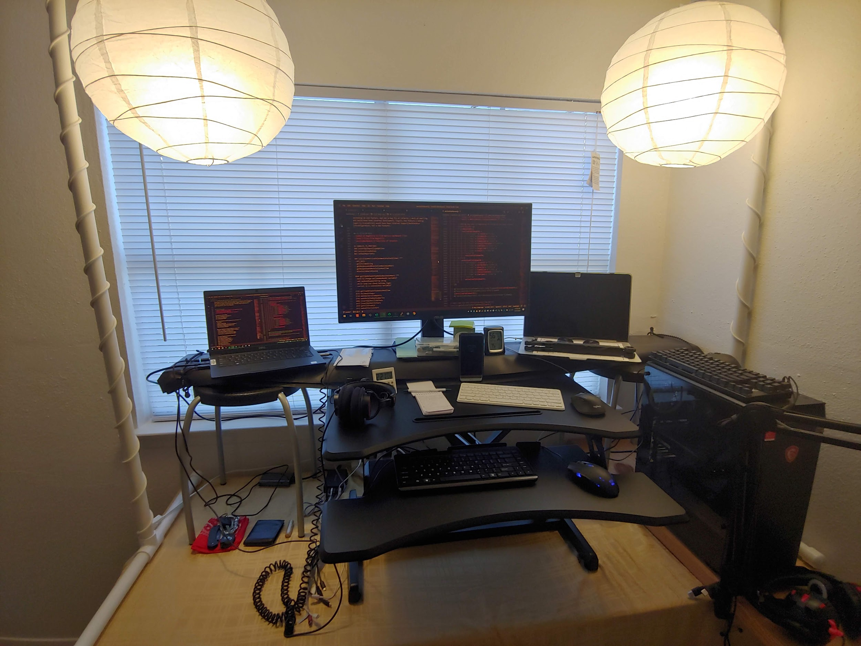
Closing
Thanks to SHPE, AHH, and attendees!
https://www.hispanichackers.com
https://www.linkedin.com/in/timothyhoang
Parting thoughts...
Always remain a student.
Leave things better than you found it.
Comfort and ergonomics are key
Notes:
Hispanic Hackers https://www.hispanichackers.com/
Tim’s LinkedIn https://www.linkedin.com/in/timothyhoang/
Slides Link https://docs.google.com/presentation/d/1Kiwb1npDhaCeL4b7mH5KmGeIo2vqXaT3Ch-oOCfIfj4/edit?usp=sharing
Github Link https://github.com/timh1203/python_talk_shpe

